Slide 1

WILL THEY CLAIM IT
2ND Hackathon
By:
Geetanjali Gupta
Sayli Londhe
Gaurav P Mahajan

Slide 2


POTENTIAL BUSINESS PROBLEMS
Create machine learning model to predict claims will made or not as it leads to a lot of benefits and solve some other supplementary problems too.
This is crucial because it will be directly related to companies profit and growth.

Slide 3

Who are the stakeholders?
Internal stakeholders :
Insurer, Owners, CEOs
claim managers
claim assessors etc.
External stakeholders :
customers i.e. insured
Agents/ Agencies
Indirect stakeholders:
Banks & Financial Intermediaries
trade partners
investors

Slide 4

WHY SOLVE THIS PROBLEM?
Business Impact
Improve prediction -> Make decisions, improve the profit share in claiming process by predicting it early.
Improve prediction -> understand the customers (insured) behavior and claim pattern.
Improve prediction -> identify right insurance type which has less claims percentage-> guiding marketing initiatives
and much more

Slide 5
DATA
Dataset Information: The data consists of records of roughly 52310 rows and 11 features.
ID | The identification record of every observation
Agency | Name of agency
Agency Type | Type of travel insurance agencies
Distribution Channel | Distribution channel of travel insurance agencies
Product Name | Name of the travel insurance products
Duration | Duration of travel
Destination | Destination of travel
Net Sales | Amount of sales of travel insurance policies
Commision (in value) | The commission received for travel insurance agency
Age | Age of insured
Claim | Claim Status
The evaluation metric for this project is Precision score.

Slide 6
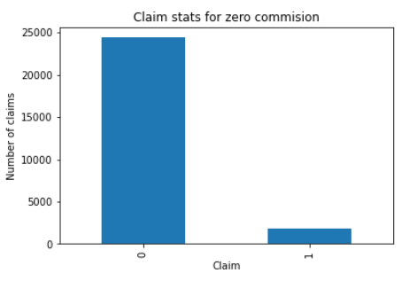
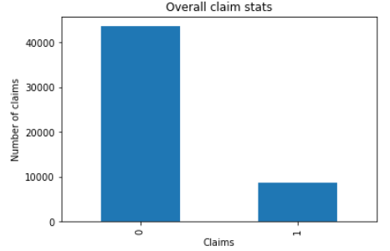
INSIGHTS
This is the claim statistics for claims which has zero commission charges:
For 0 commission claims stats
Claims not made | 93%
Claims made | 7%
For Overall claims stats
Claims not made | 83%
Claims made | 17%
Zero commission claims have more probability of not claiming .

Slide 7
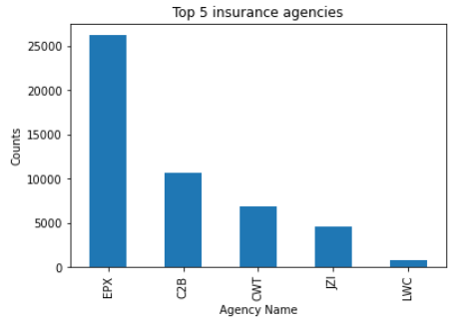
INSIGHTS
Top 5 insurance agencies
Top 5 Agencies
Agency Name | Counts | Overall %
EPX | 26218 | 50%
C2B | 10615 | 20%
CWT | 6813 | 13%
JZI | 4619 | 9%
LWC | 806 | 2%
Top 5 insurance agencies out of 16 contributes around 94 % of insurance.

Slide 8
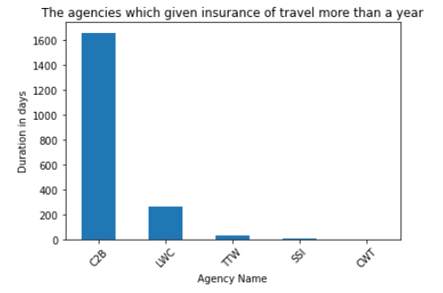
INSIGHTS
Top Agencies which has provided insurance for duration more than a year
C2B is the agency which has provided maximum number of insurances which are more than a year

Slide 9
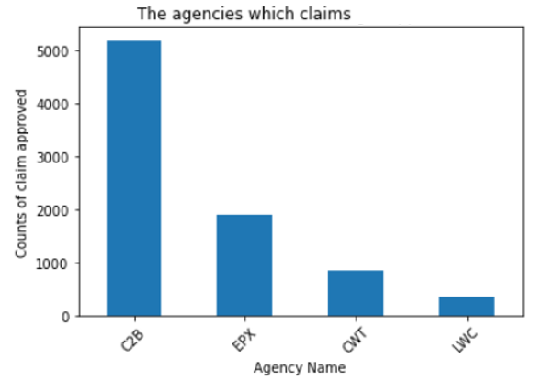
INSIGHTS
Top Agencies whose customer made claims
C2B is the agency which has most claims.
This is the same one which is second largest selling agency and also the largest one with selling insurance for duration more than a year

Slide 10
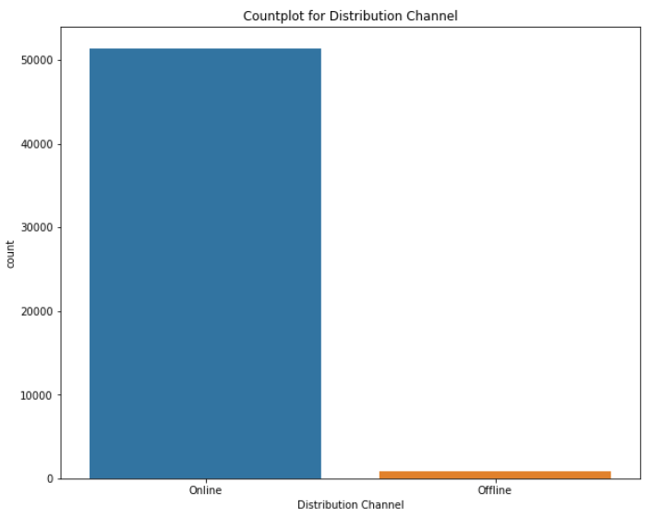
INSIGHTS
Stats for distribution channel
For Distribution channel
Online | 98%
Offline | 02%
Majority insurances are through online distribution channel.

Slide 11
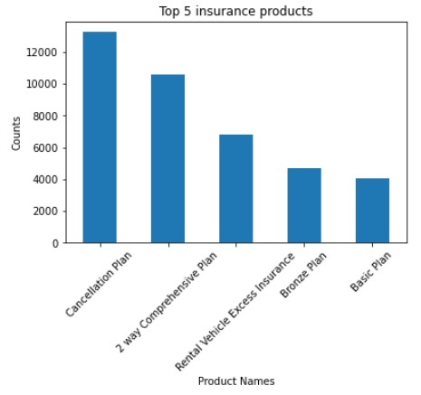
INSIGHTS
Top 5 insurance names
Top 5 Agencies
Agency Name | Counts | Overall %
Cancellation Plan | 13254 | 25%
2 way Comprehensive Plan | 10555 | 20%
Rental Vehicle Excess Insurance | 6813 | 13%
Bronze Plan | 4723 | 9%
Basic Plan | 4042 | 8%
Top 5 insurance plans out of 25 contributes around 75 %. So, company should focus more on these plans.

Slide 12
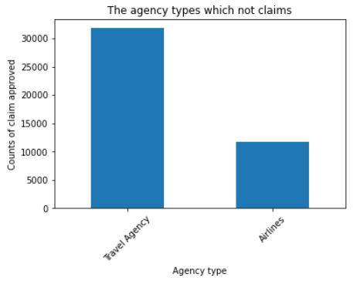
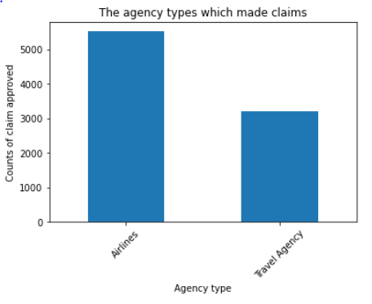
INSIGHTS
Agency types w.r.t claim settlements
Travel agency type has more insurances and less claim settlement, so company is getting more profit in this type.

Slide 13
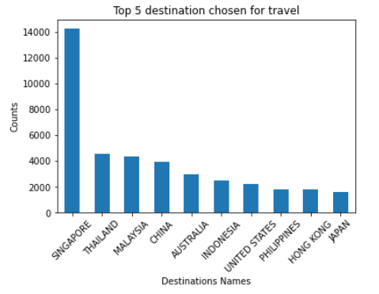
INSIGHTS
Top 10 destinations chose for travel
Top 10 destinations out of 97 contributes around 76 %. So, company should pay attention to this destinations.

Slide 14
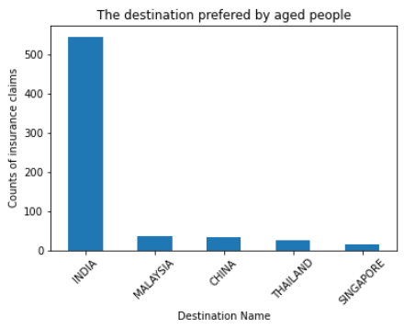
INSIGHTS
Destination preferred by aged people
India is most preferred destination for aged people.

Slide 15
Summary of Insights
0 commission claims have more probability of not claiming.
Top 5 insurance agencies out of 16 contributes around 94 % of insurances.
C2B is the agency which has provided maximum number of insurances which are more than a year and also has most claims.
Majority insurances are through online distribution channel.
Top 5 insurance plans out of 25 contributes around 75 % & Top 10 destinations out of 97 contributes around 76 %. So, company should focus more on these plans.
Travel agency type has more insurances and less claim settlement, so company is getting more profit in this type.
India is most preferred destination for aged people.

Slide 16
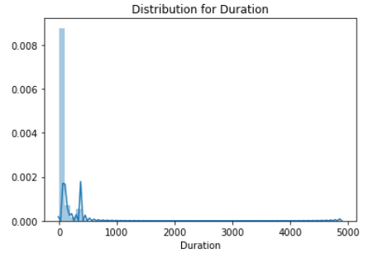
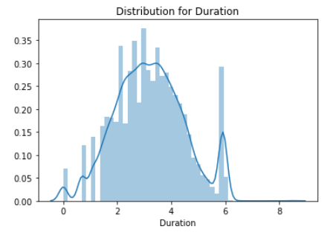
PIPELINE
Missing Values:
There are no missing values in the data.
Skewness treatment :
‘Duration’ feature is rightly skewed. It is treated with logarithm function

Slide 17
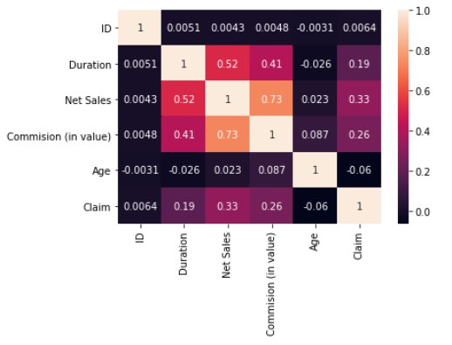
PIPELINE
Correlation methods were used to check the dependability of variables with each other:
As Net Sales & commission (in value) features are corelated, So we have dropped commission (in value)

Slide 18
MODELS AND APPROACHES Following models were used for machine learning: 1. Decision Tree Classifier 2. Random forest classifier 3. XGBoosting Classifier 4. Ada Boost Classifier

Slide 19
EVALUATION & RESULTS
Below are the precision score and accuracy score results for all the models
Parameters | Precision Score | Accuracy score
Models
Decision Tree Classifier | 0.76 | 0.92
Random Forest classifier | 0.83 | 0.93
XGBoosting Classifier | 0.81 | 0.92
Ada Boost Classifier | 0.80 | 0.88
The Precision score and Accuracy score were highest for Random forest classifier.

Slide 20
NEXT STEPS
If time permitted, we could have tried the following :
● Better feature engineering.
● An ensemble of different models.
● Hyper Parameter Tuning.

Slide 21
ANY QUESTIONS ?

Slide 22
THANK YOU

